Slide 1


SHIELD
INSURANCE
The main objective of this project is to conduct a thorough analysis of the business, focusing on customer base, revenue generation, growth rates, policy changes, settlement and demographics. This aims to provide valuable insights for informed decision-making.
TOOL USED : POWER BI

Slide 2

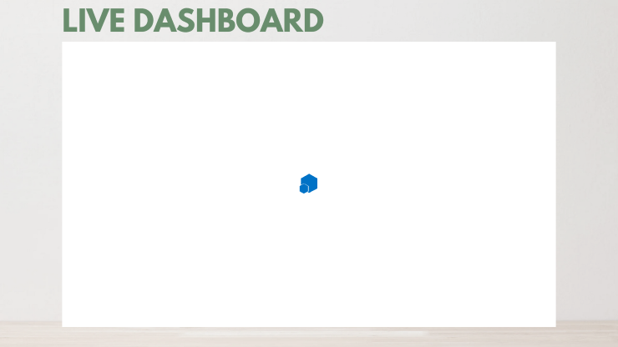

GENERAL INFORMATION
Data Timeline : From Nov 1st 20222 to Apr 31 2023.
The Report is in 3 different parts :
General View: Consolidated Report Summary
Sales View : Contains Sales Performance
Age Segment : Age - Wise Sales Performance
To View the Live Dashboard : Click Here
To View the User Guide : Click Here

Slide 3

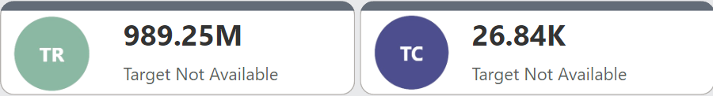
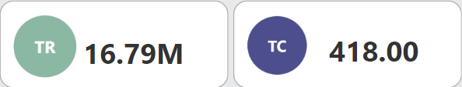
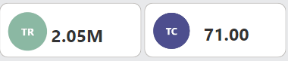
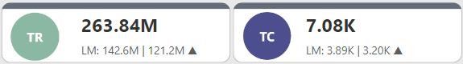
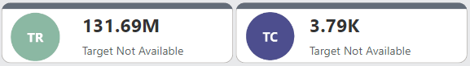

GENERAL FINDINGS
KPI's
Total Revenue : 989.25 M
Total Customers : 26841
Daily Average Customer Growth : 148(Approx)
Dates and Months :
Date with Highest Revenue(16.79 M) and Highest Customers(418)were acquired is: 25 March 2023
Date with Lowest Revenue(2.05 M) and Highest Customers (71) were acquired is: 17 Nov 2022.
Month with Highest Revenue(264 M) and Highest Customers(7081) were acquired is: March 2023
Month with lowest Revenue(131.7 M) and lowest Customers(3787) were acquired is: Nov 2022
Interesting Point :
March is the busiest month in the company, most people buy policies in the month of March to qualify for the Tax Exemption as March is the last month of Indian Financial Year

Slide 4
GENERAL FINDINGS
KPI's
Total Revenue: 989.25 M
Total Customers : 20841
Dates and Months :
Date with Highest Revenue and Highest Customers were acquired is: 25 March 2023
Date with Lowest Revenue and Highest Customers were acquired is: 17 Nov 2022.
Month with Highest Revenue and Highest Customers were acquired is: March 2023
Month with lowest Revenue and Highest Customers were acquired is: Nov 2022
Interesting Point :
March is the busiest month in the company, most people buy policies in the month of March to qualify for the Tax Exemption as March is the last month of Indian Financial Year.

Slide 5
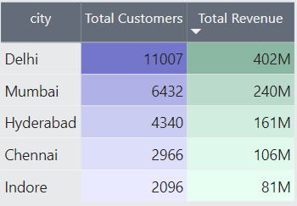
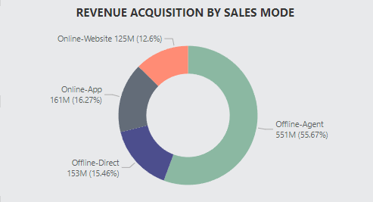
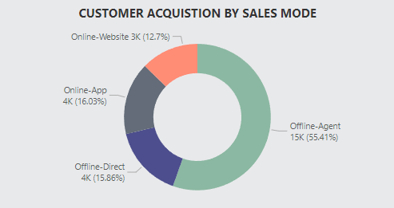
GENERAL FINDINGS
City
City which Acquired Highest Total Revenue and acquired highest number of customers: Delhi
City which acquired lowest Total Revenue and acquired highest number of customers: Indore
Sales Mode :
Most preferred sales mode by Customers(55%): Offline-Agent
Least preferred sales mode(12%) : Online-Website

Slide 6
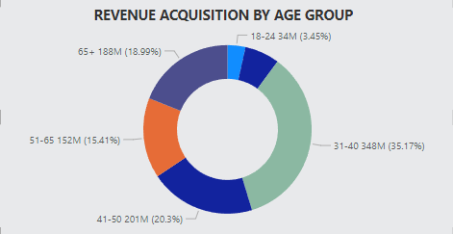
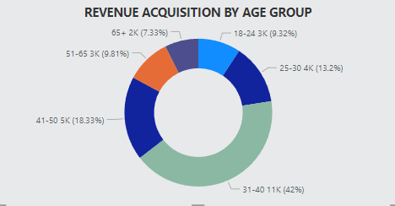
GENERAL FINDINGS
Age Segment :
Age Segment with highest Revenue and customer acquisition is: 31-40
Age Segment with lowest Revenue acquisition is: 18-24
Age Segment with lowest Customer acquisition is: 65+
18-24 segment receives highest Revenue (7.5 M) in the month of Jan whereas all other age segment gained their peak in March.

Slide 7

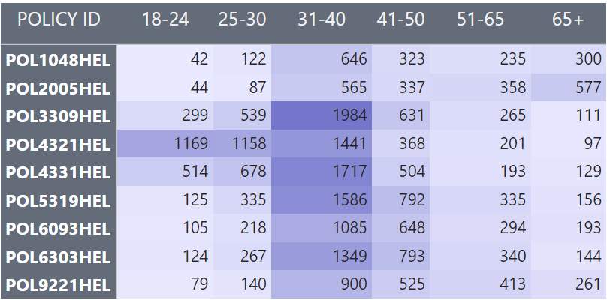
GENERAL FINDINGS
Policy Preference :
Policy with highest BPA (120K) and highest BCA (10 M) is: POL20005HEL
Policy with highest Revenue Acquisition (324M): POL20005HEL
Policy with highest Customer Acquisition (4434): POL20005HEL

Slide 8
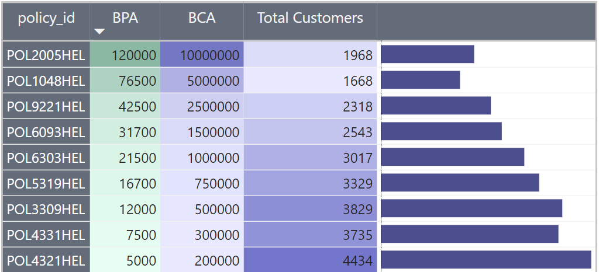
INSIGHTS
Why POL3309HEL broke the trend ?
The purchasing behavior of individuals regarding insurance policies demonstrates an inverse relationship with the premium amounts associated with said policies. Put succinctly, policies commanding higher premiums experienced lower sales volumes in comparison to those with lower premium rates. However, there exists an exception to this trend in the form of POL339HEL. Despite its comparatively higher cost, this particular policy enjoys a notable level of consumer adoption, possibly attributable to supplementary benefits not offered by its counterparts.

Slide 9
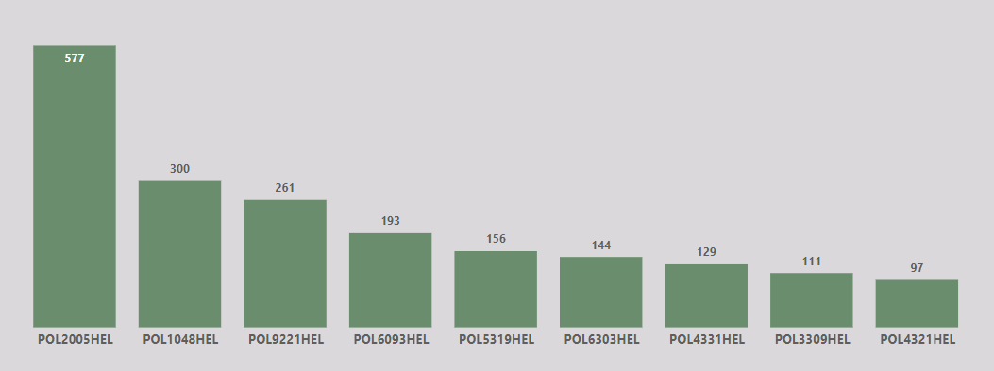
INSIGHTS
Why old people buy costly policies ?
The data suggests that old people buy policies with costly premiums. Like, 577 senior citizens, which is a predominant headcount, buy POL2005HEL with premium of 120K. It’s because in old age most of the people came up with pre-existing diseases and are more likely to require frequent medical care, insurance companies usually charge a higher premium to cover them.
So, it’s quite normal to say that most of the people don’t even buy the policies.
To answer this problem, company can analyze health risks in the 65+ age group and adjust premiums accordingly to accurately reflect potential claims costs.

Slide 10
INSIGHTS
Why people don’t trust online mode ?
Based on the data, with over half of recorded individuals (55%) purchasing policies through agents, transitioning them to online channels could significantly reduce costs. To facilitate this transition, the insurance company could consider several measures:
Improve online platforms for easier policy purchase.
Launch digital marketing to promote online options.
Offer discounts for online purchases.
Train agents to guide customers to online channels.
Educate customers on online benefits.
Provide robust online customer support.
Gather feedback for continuous improvement.

Slide 11
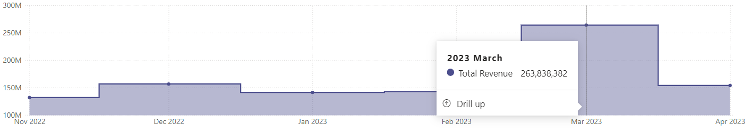
INSIGHTS
Why march is the busiest month ?
March is crucial in India's financial calendar, particularly for insurance purchases, driven by tax-saving motives. As the fiscal year ends, individuals rush to optimize tax liabilities, favoring insurance policies for their tax benefits. Strategic purchases, aided by tailored offerings and promotions, dominate this period. Additionally, the need for year-end tax declarations accelerates policy acquisitions. In essence, March represents a vital window for insurance investments in India.
An insurance company can capitalize on other months also by:
Offering tax-saving insurance products.
Providing incentives for March purchases.
Training agents on tax-saving policies.
Utilizing digital channels for promotions.
Streamlining processes for efficiency.

Slide 12

THANK YOU
Do you have any questions ?
Feel free to ask anything….

Slide 13

LIVE DASHBOARD

